Slide 1


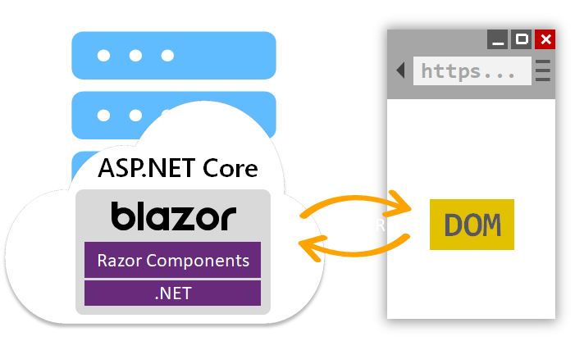

Blazor 2021
Jeff Maxwell

Slide 2
Jeff Maxwell
Education
BS in CS from OSU
Experience
25+ Years in Development
Currently
Security Architect at Inspire Brands
MS in CS from OC
15+ Years in Oil & Gas
4 Years as Adjunct Instructor
Adjunct Instructor at OCU

Slide 3

.NET Core & Framework

Slide 4
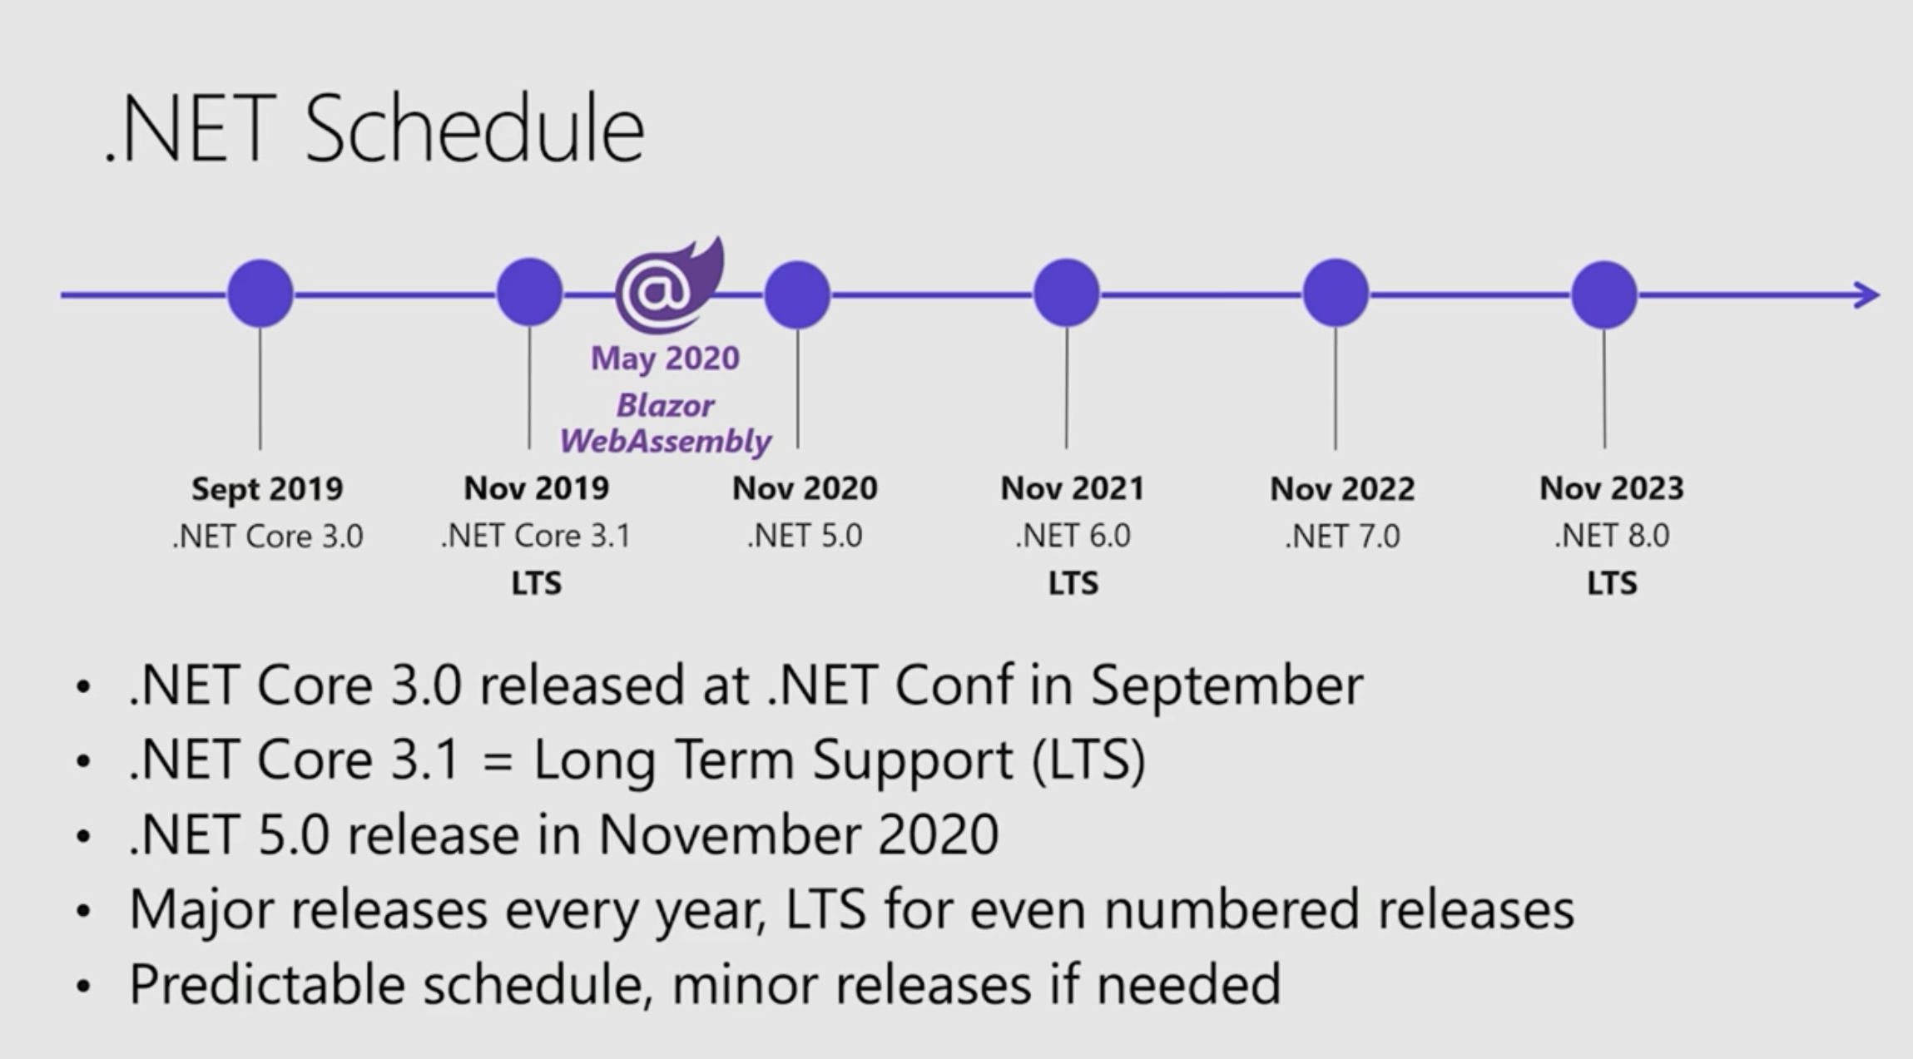

Slide 5
Blazor
Now part of the Core .NET 5.
Both Client-side and Server-side Rendering
Full-Stack C# development
Share C# code on client and server
Supported by all Browsers (Web Assembly)
Faster than JavaScript

Slide 6
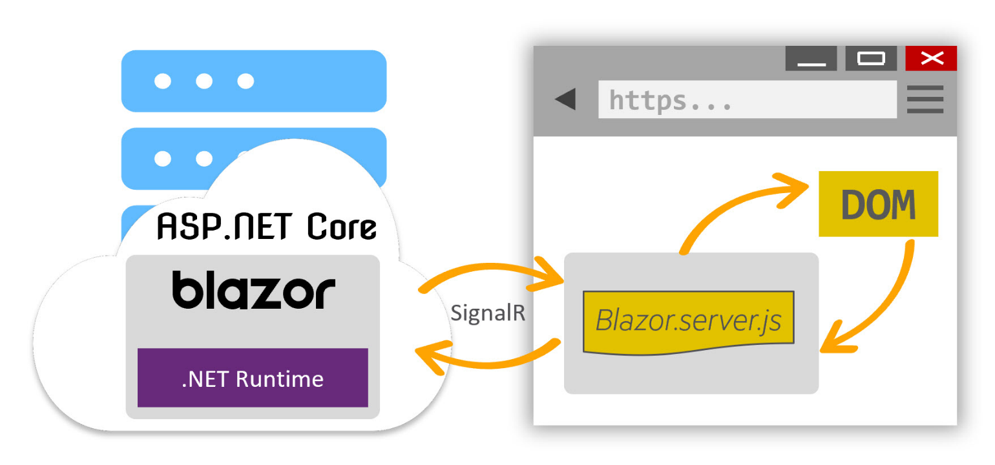
Server-Side Blazor
Hosts Razor components that update the UI via SignalR calls to the server and update the DOM.

Slide 7
Demo

Slide 8
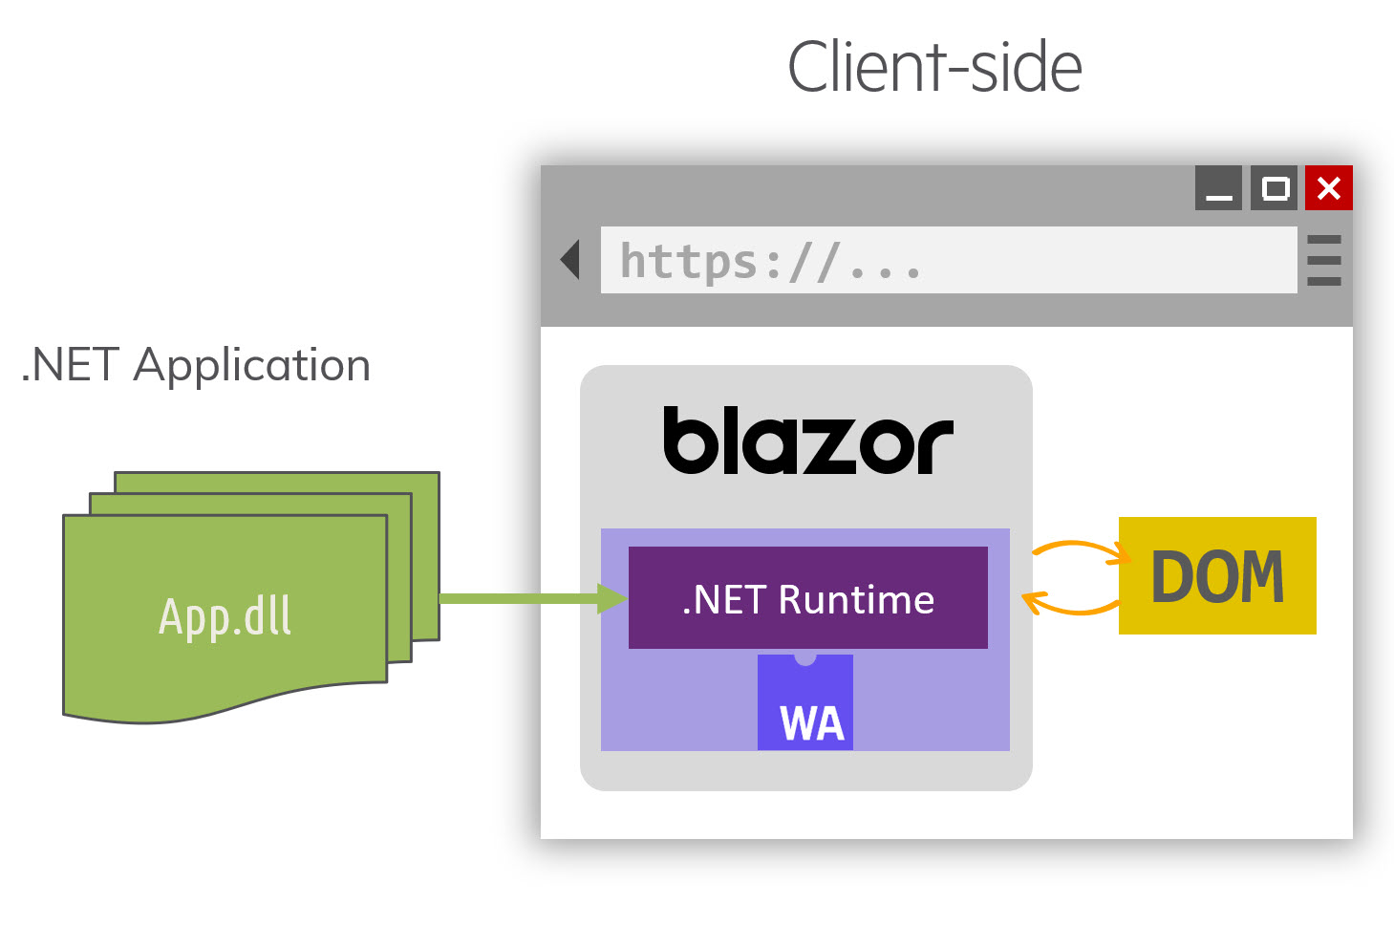
Client-Side Blazor (Web Assembly)
Browser will download the WASM file and any needed .DLL and run in the brower

Slide 9

What is Web Assembly?
Web Assembly (WASM) is an open binary standard that defines a portable code format for programs designed to run in web browsers.
https://webassembly.org

Slide 10
Demo

Slide 11
What if I have an existing MVC Page?
I have built all my apps in ASP.NET Core MVC do I have to start over?
NO

Slide 12
Demo

Slide 13


What’s Next (MAUI)
Multi-Platform App UI
Build Applications for:
Web
Windows
MacOS
iOS
Andrioid

Slide 14
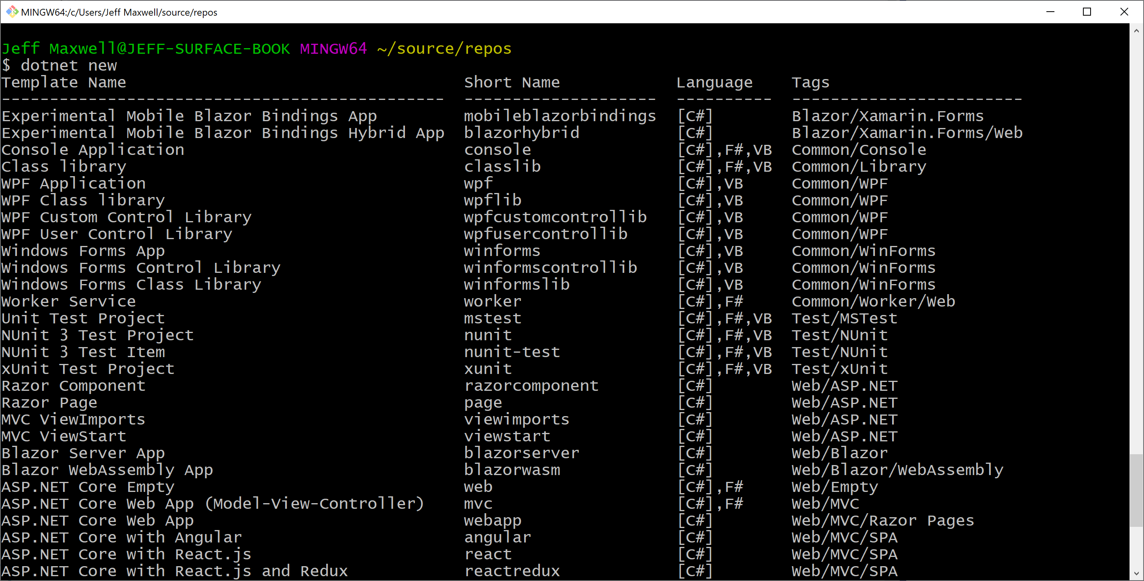
dotnet new -i Microsoft.MobileBlazorBindings.Templates::0.5.50-preview

Slide 15
Add Templates
dotnet new -i Microsoft.MobileBlazorBindings.Templates::0.5.50-preview

Slide 16
Demo

Slide 17
Links
Blazor Download – https://blazor.net
Blazor Workshop – https://aka.ms/blazorworkshop
Try .NET – https://aka.ms/csharpintro
Blazor + Electron – https://aka.ms/blazorelectron
Blazor + WebWindow = https://aka.ms/webwindow
Awesome Blazor Community – https://aka.ms/awesomeblazor

Slide 18


Slide 19
Questions
github.com/jeff-maxwell
jeff@tcnsolutions.com

